Slide 1
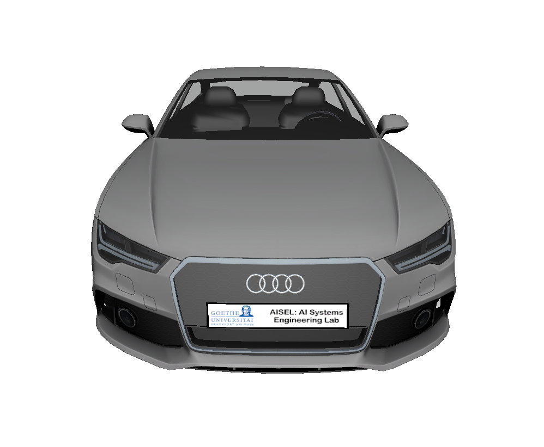



Towards Explainable AI Systems for Traffic Sign Recognition and Deployment in a Simulated Environment
Presented by
Pascal Fischer & Alen Smajic
with support of the
AI Systems Engineering Lab

Slide 2
Motivation and Introduction
Recent advances in Machine Learning pushing the boundaries of real world AI applications
Numerous challenges for our society and the system engineers
Ethical AI, privacy and transparency are becoming increasingly relevant
First attempt at tackling the problem of traffic sign recognition as systems engineers
Focus on the development of an explainable and transparent system with the use of concept whitening layers
Introduction of a simulation used for model deployment, performance benchmarking, data generation and further domain model research

Slide 3
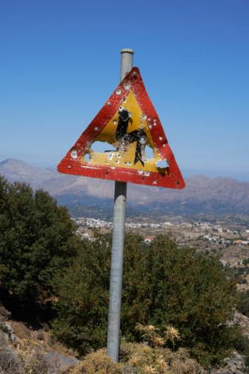
1. User View
1.1 CONTEXT
Traffic signs are part of the road infrastruture
Traffic sign locations and positioning on the road
Traffic sign shapes, colors and materials
Outdoor environment and its influence on visibility
Accidents, vandalism and weather influence on traffic signs

Slide 4
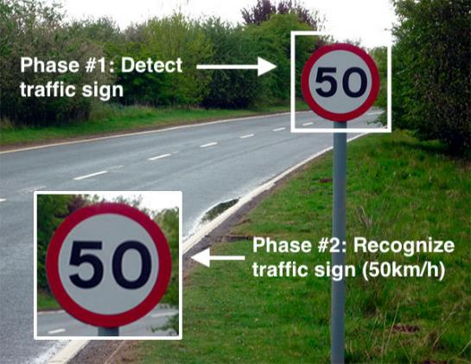
1. User View
1.2 TASK
Recognition of traffic signs in real-time
Detect and classify signs in various conditions and environments
Focus on transparency and explainability

Slide 5
1. User View
1.3 PERFORMANCE CONSTRAINTS
Real-time performance
High prediction performance with high accuracy
High recall for the detection and high accuracy for the classification
High detection rate of small objects (on great distances)

Slide 6
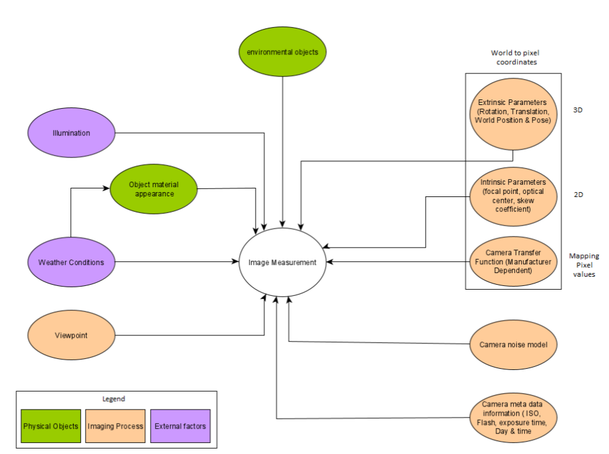
2. Modeling View
2.1 CONTEXTUAL WORLD MODEL
Centered around the image measurement

Slide 7
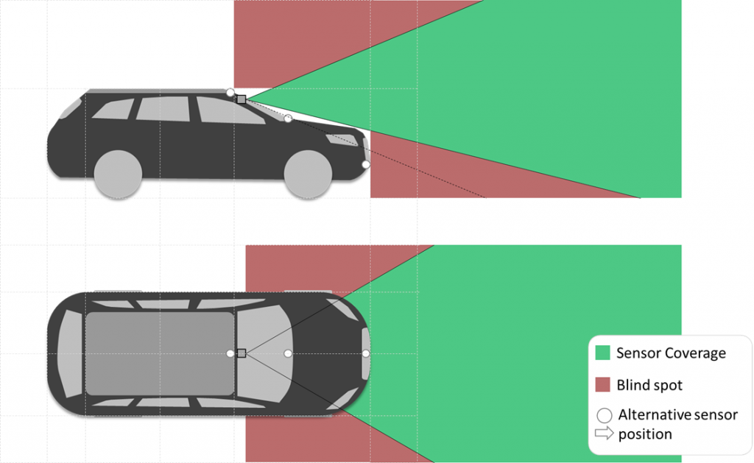
2. Modeling View
2.1 CONTEXTUAL WORLD MODEL
CAMERA SENSOR MODEL
Mounted on the roof, facing to the front
Big field of view, reducing blind spots
Robustness to camera movement and shaking
Good performance in low illumination conditions
Clear high resolution images at any time

Slide 8
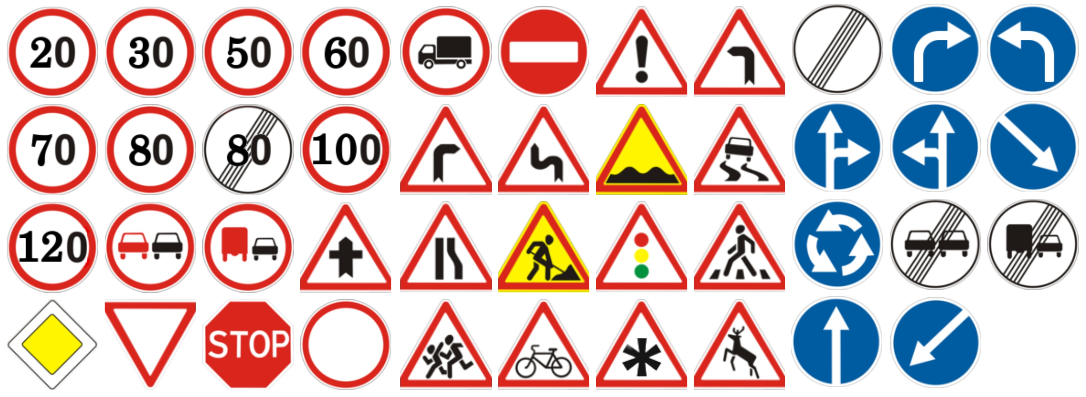
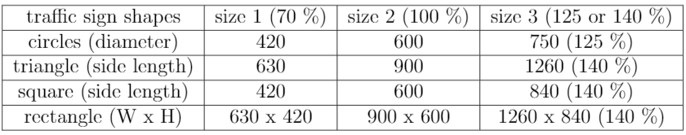
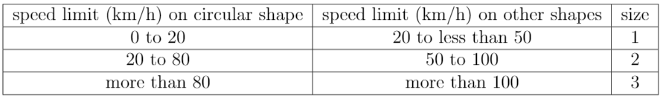
2. Modeling View
2.1 CONTEXTUAL WORLD MODEL
TRAFFIC SIGN APPEARANCE
43 Traffic Signs from German Traffic Sign Recognition Benchmark
Traffic sign font Linear-Antiqua family according to DIN 1451-2
Traffic sign sizes
Speed limit for
size class

Slide 9

2. Modeling View
2.1 CONTEXTUAL WORLD MODEL
TRAFFIC SIGN PLACEMENT
Maximum of three signs on a single post (two if regulatory signs)
Placed in general on clearly visible locations on the right side of the road
may be placed on the left alone or above the road alone, or on both sides
may be curved in such a way that they can also be seen from the side
lower edge should be 2m above street level, 2.20m above cycle paths, 4.50m on gantries, 0.60m on islands and traffic dividers
must not be placed within the roadway. The lateral distance from it should be 0.50m within built-up areas and never less than 0.30m. For outside built-up areas it should be 1.50m

Slide 10
2. Modeling View
2.1 CONTEXTUAL WORLD MODEL
TRAFFIC SIGN COLORS
The colors used for traffic signs are regulated by the DIN 6171
The color charts „RAL-F 7 Reflexfarben“ and „RAL-F 81 Farben im Straßenverkehr“ show the colors of traffic signs in new condition
The color shades specified in the RAL-F 7 special color series are:
RAL 2006, RAL 3019, RAL 3030, RAL 5016, RAL 6030, RAL 8026, RAL 9014, RAL 9019
The color shades specified in the RAL-F 81 special color series are:
RAL 1023 (yellow), RAL 2009 (orange), RAL 3020 (red), RAL 4006 (purple), RAL 5017 (blue), RAL 6024 (green), RAL 7042 (gray A), RAL 7043 (gray B), RAL 9016 (white), RAL 9017 (black)

Slide 11

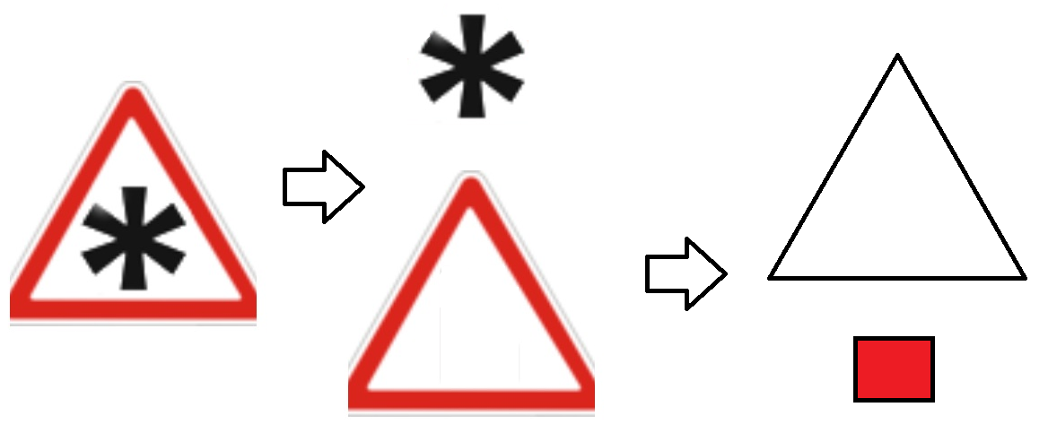
2. Modeling View
„part of” hierarchy
Depends on the observer
Partonomy
2.1 CONTEXTUAL WORLD MODEL
CONCEPTUAL DECOMPOSITION OF TRAFFIC SIGNS
Concepts consists of further concepts
Decomposition could not be clearly determined
Conceptual decomposition is ambigous

Slide 12
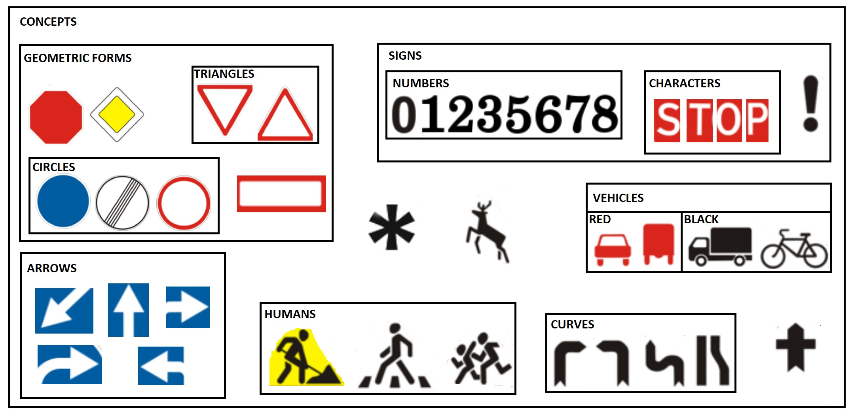
2. Modeling View
2.1 CONTEXTUAL WORLD MODEL
CONCEPTUAL DECOMPOSITION MODEL

Slide 13
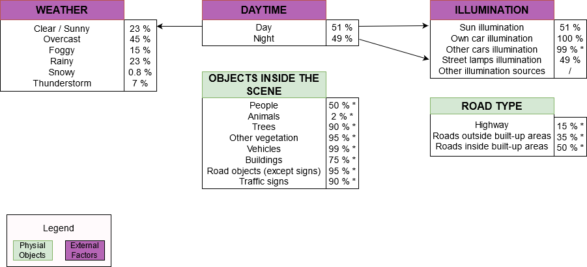
2. Modeling View
2.1 CONTEXTUAL WORLD MODEL
PROBABILISTIC ENVIRONMENTAL WORLD MODEL

Slide 14
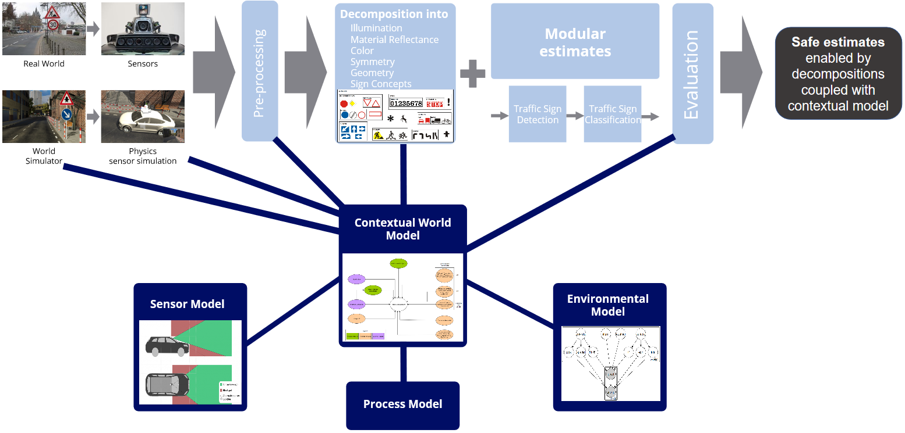
2. Modeleing View
2.2 SYSTEM DESIGN

Slide 15
2. Modeling View
2.3 PRIVACY AND TRANSPARENCY BY DESIGN
Protect the privacy of each individual affected by our system
No video storage component => no privacy concerns
Use camera sensor only for real-time traffic sign recognition
Transparency by deploying concept whitening layers within our deep learning models

Slide 16
3. Implementation View
3.1 TRAFFIC SIGN DETECTION USING VIOLA & JONES
Selecting Haar-like features
Creating an integral image
Running Adaboost training
Creating classifier cascades

Slide 17


3. Implementation View
Edge-features
Line-features
Four-sided-features
3.1 TRAFFIC SIGN DETECTION USING VIOLA & JONES
HAAR-LIKE FEATURES

Slide 18
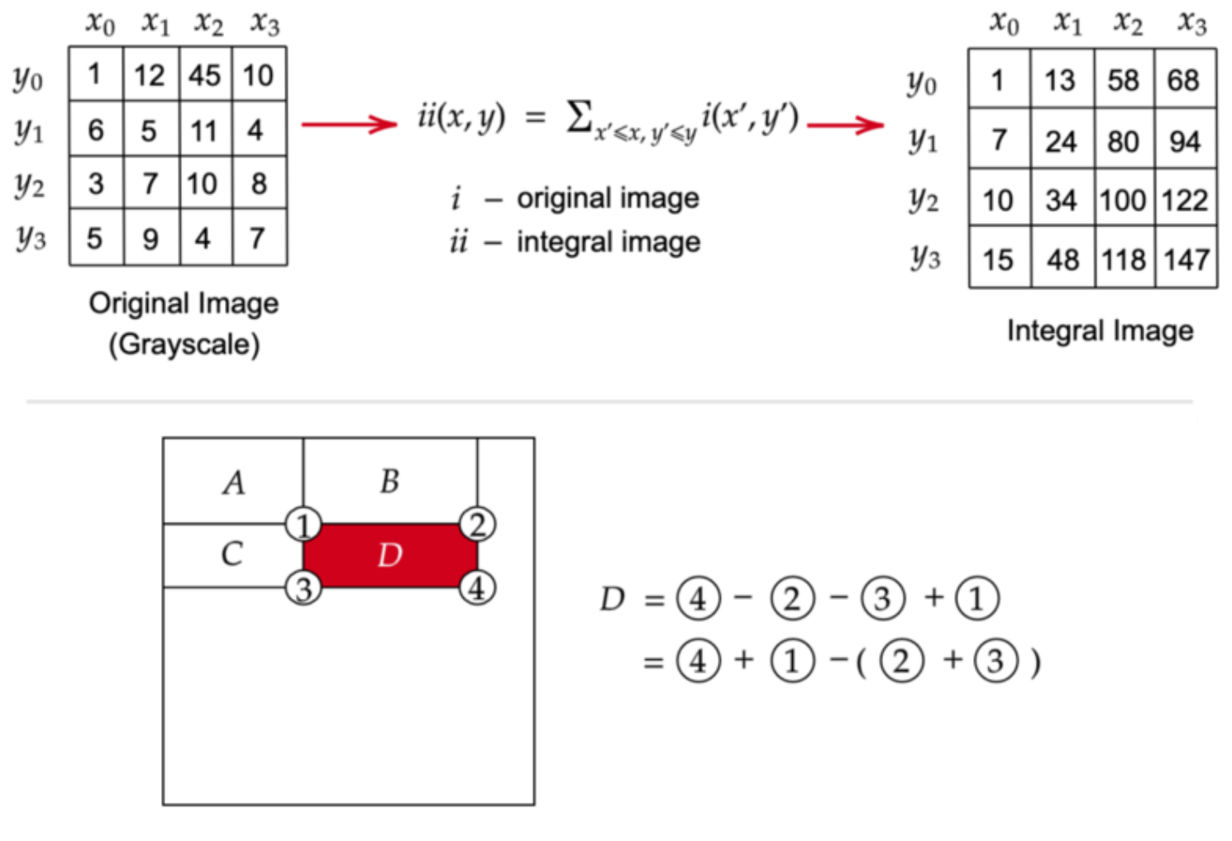
3. Implementation View
3.1 TRAFFIC SIGN DETECTION USING VIOLA & JONES
INTEGRAL IMAGE

Slide 19
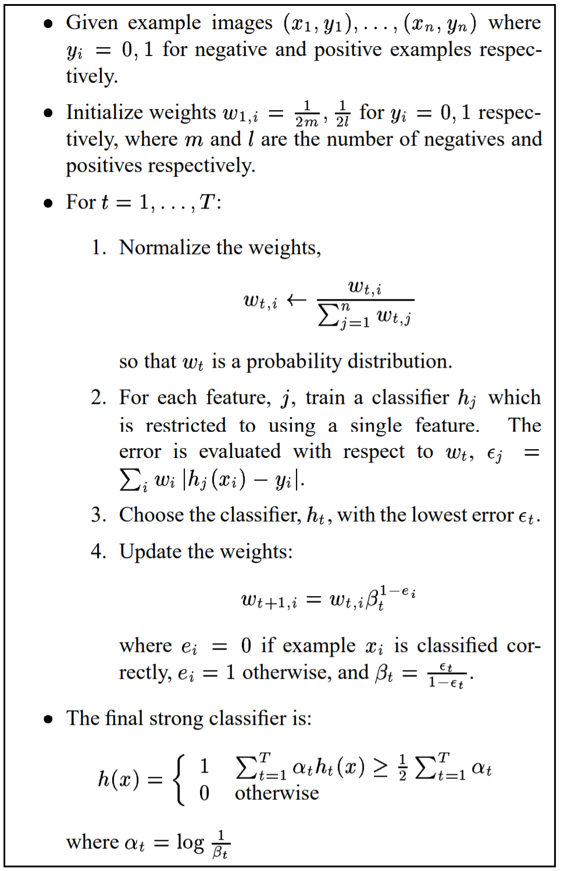
3. Implementation View
3.1 TRAFFIC SIGN DETECTION USING VIOLA & JONES
ADABOOST
~160,000 possible features in a 24x24 detector window
Identify the best features
Each feature is a weak learner
Checks performance of all classifiers that are supplied to a feature
Classification by strong response as positive, weak as negative
Result is a strong classifier -> boosted classifier

Slide 20
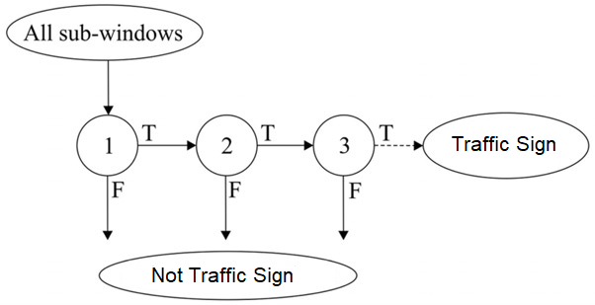
3. Implementation View
3.1 TRAFFIC SIGN DETECTION USING VIOLA & JONES
CASCADE CLASSIFIER

Slide 21
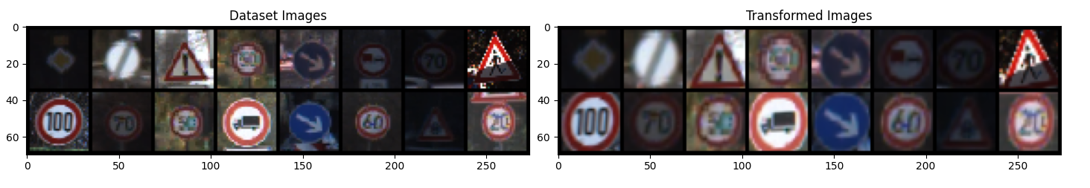
3. Implementation View
3.1 TRAFFIC SIGN DETECTION USING VIOLA & JONES
DATASET
Positive examples from rebalanced GTSRB
Negative examples from simulation data, GTSDB, and downloaded images
Preprocessing with Spatial Transformer Network STN

Slide 22
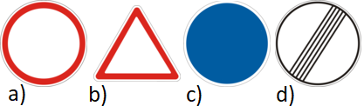
3. Implementation View
3.1 TRAFFIC SIGN DETECTION USING VIOLA & JONES
4 different classifiers for classes :
a) white circle red border
b) white triangle red border
c) blue circle
d) white circle with black diagonal lines
Minimum hit rate of 99%
Maximum false alarm rate of 30%
1000 positive and 2000 negative examples
train only on main color channel and grayscale
TRAINING

Slide 23
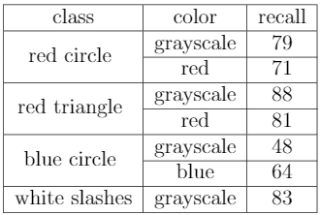
3. Implementation View
3.1 TRAFFIC SIGN DETECTION USING VIOLA & JONES
VALIDATION
Test dataset from GTSDB
600 images
~1000 bounding boxes
blue circle gets better result on blue color channel

Slide 24
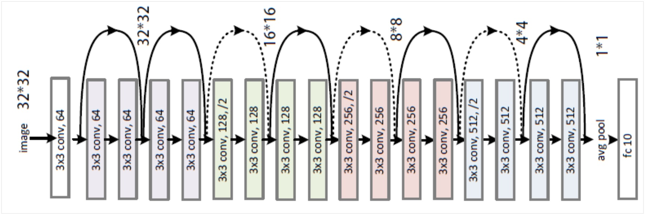
ResNet18
3. Implementation View
3.2 TRAFFIC SIGN CLASSIFICATION
ResNet18
Concept
Whitening

Slide 25
3. Implementation View
3.2 TRAFFIC SIGN CLASSIFICATION
German Traffic signs
50.000 collected images
43 classes
Different weather conditions and illumination
Variations of distance, partial occlusion and rotation
12.500 images in testset
DATASET - GTSRB

Slide 26
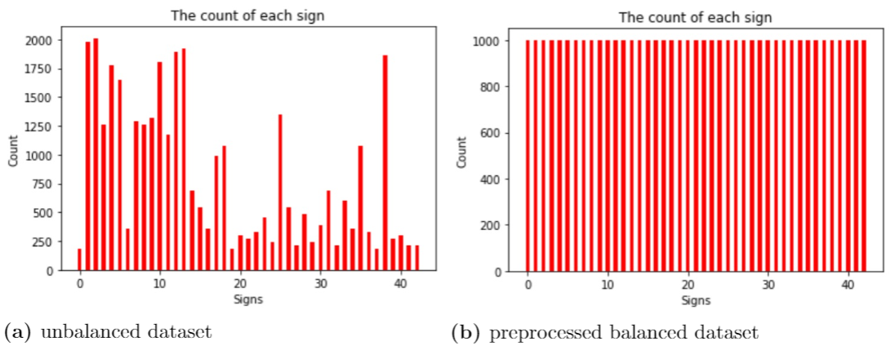
3. Implementation View
3.2 TRAFFIC SIGN CLASSIFICATION
Choose 1000 random images of each class with at least 1000 images
Add for each image of a class with less than 1000 images an additional rotated version with angle between [-20, 20]
DATA PREPROCESSING

Slide 27
Background Class
Epochs
Learning Rate
3. Implementation View
3.2 TRAFFIC SIGN CLASSIFICATION
TRAINING
1000 images from negatives of object detection dataset
10
1e-2
9e-1
Stochastic Gradient Descent
Cross Entropy Loss
Momentum
Optimizer
Loss Function

Slide 28
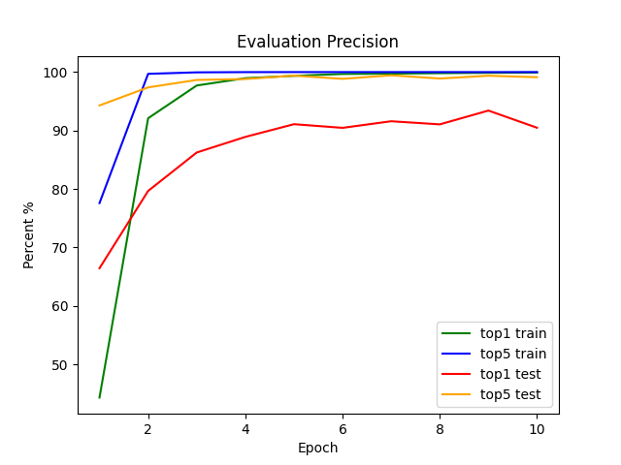
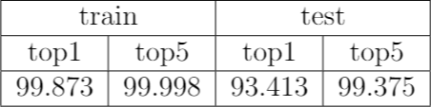
3. Implementation View
3.2 TRAFFIC SIGN CLASSIFICATION
top1 and top5 precision for train- and testset
VALIDATION

Slide 29

3. Implementation View
3.3 CONCEPT WHITENING
METHODOLOGY

Slide 30
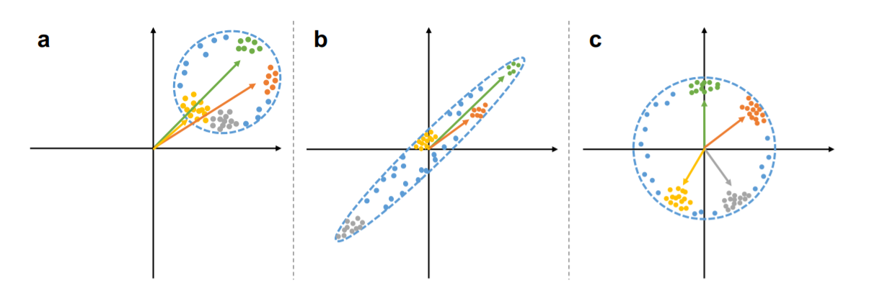
3. Implementation View
3.3 CONCEPT WHITENING
data are not mean centered
standardized data but not decorrelated
whitened data

Slide 31

3. Implementation View
3.3 CONCEPT WHITENING
CONCEPT WHITENING MODULE

Slide 32


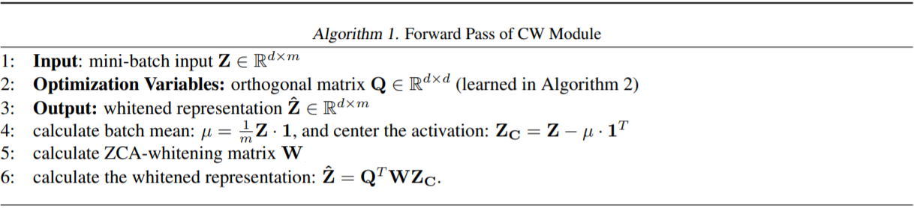
3. Implementation View
3.3 CONCEPT WHITENING
CONCEPT WHITENING MODULE

Slide 33



3. Implementation View
3.3 CONCEPT WHITENING
ZCA WHITENING

Slide 34


3. Implementation View
3.3 CONCEPT WHITENING
ALTERNATING OPTIMIZATION ON TWO STEPS 1/3

Slide 35



3. Implementation View
3.3 CONCEPT WHITENING
ALTERNATING OPTIMIZATION ON TWO STEPS 2/3

Slide 36
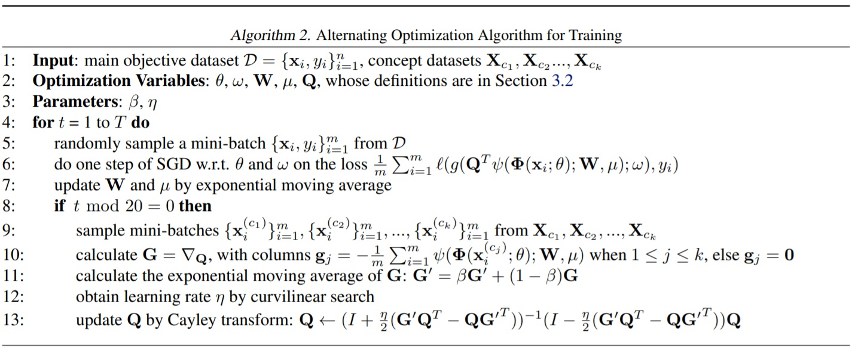
3. Implementation View
3.3 CONCEPT WHITENING
ALTERNATING OPTIMIZATION ON TWO STEPS 3/3

Slide 37
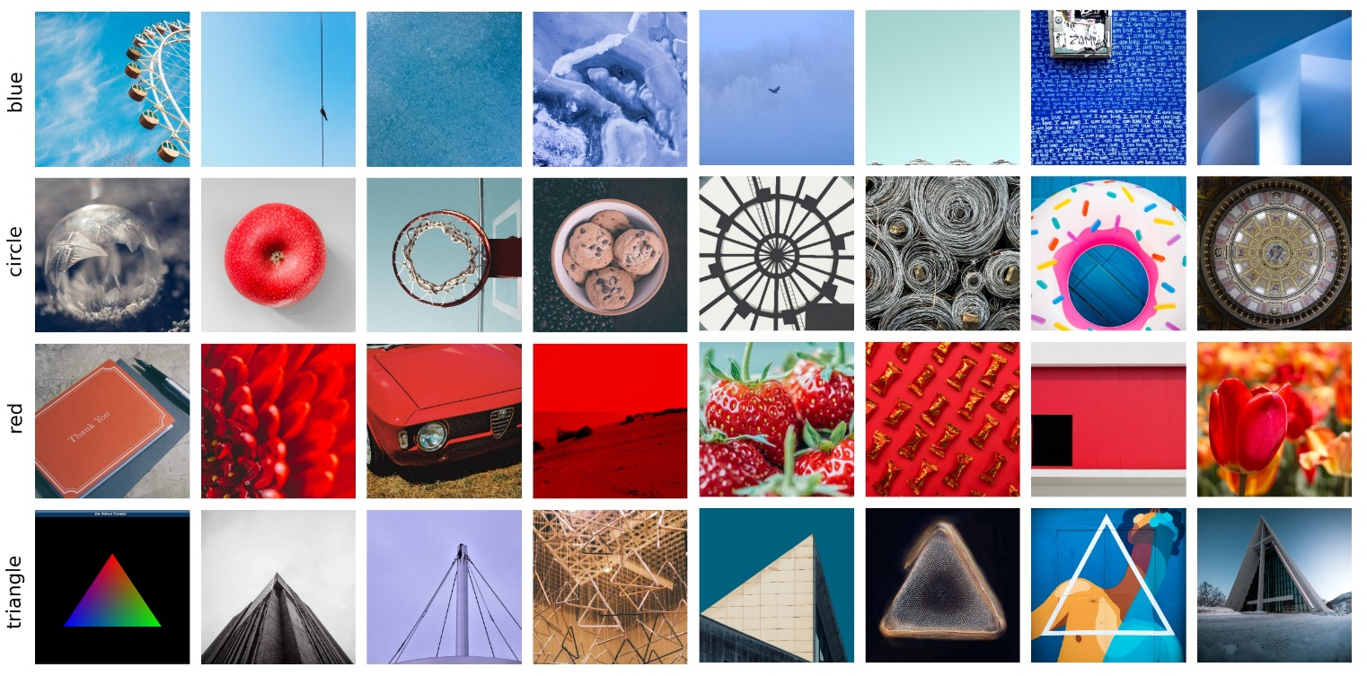
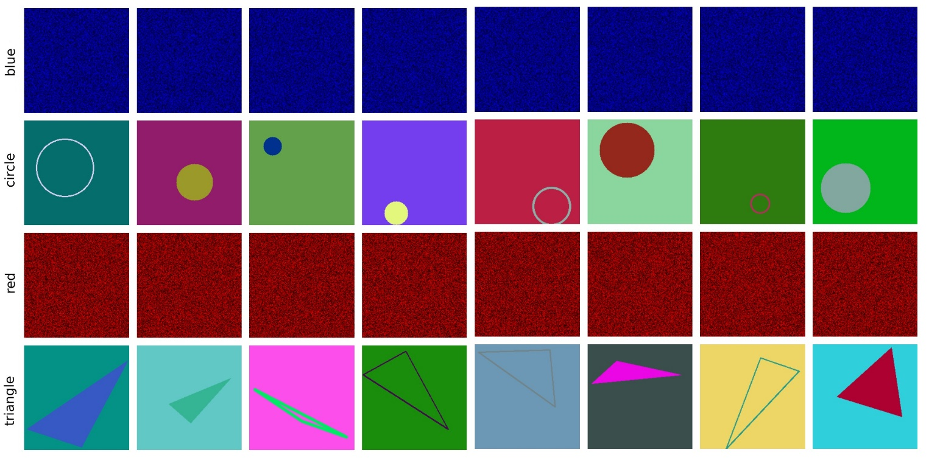
3. Implementation View
3.3 CONCEPT WHITENING
CONCEPT DATASETS
Internet Collection
500 images per concept
Formular generated
1000 images per concept

Slide 38
3. Implementation View
3.3 CONCEPT WHITENING
TRAINING
Same parameters
Training with the same parameters as without CW except learn rate of 5e-2
5th residual block
Replace batch normalization layer in pretrained ResNet18
5 epochs
Train additional epochs on trained classification network

Slide 39
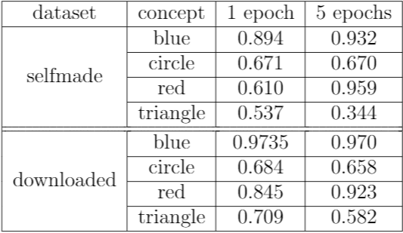
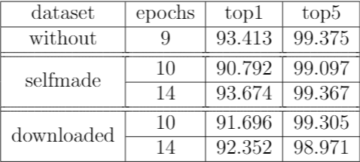
3. Implementation View
3.3 CONCEPT WHITENING
VALIDATION 1/2
Concept validation with AUC
Traffic sign recognition validation with top1, top5 precision

Slide 40
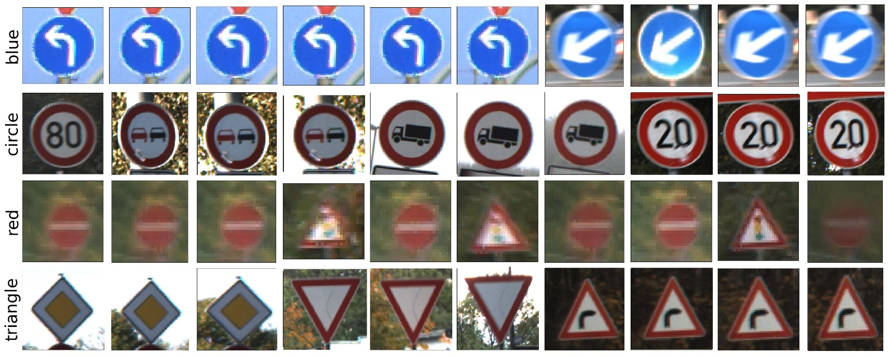
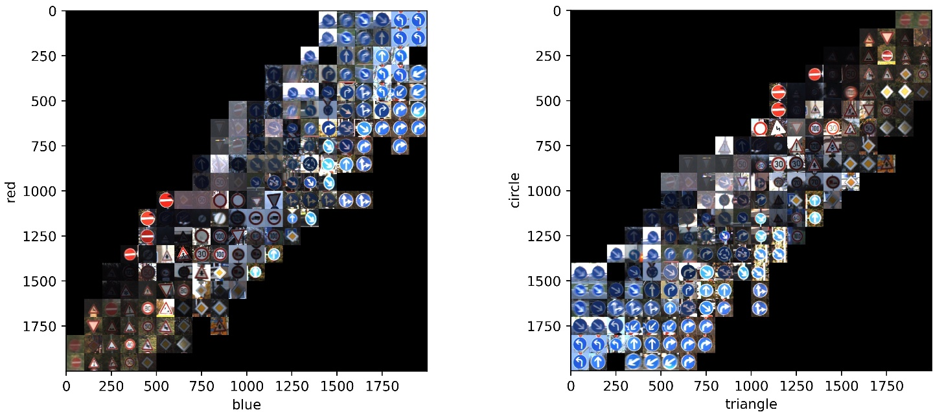
3. Implementation View
3.3 CONCEPT WHITENING
VALIDATION 2/2
Top 10 activated images
Two concepts subspace

Slide 41
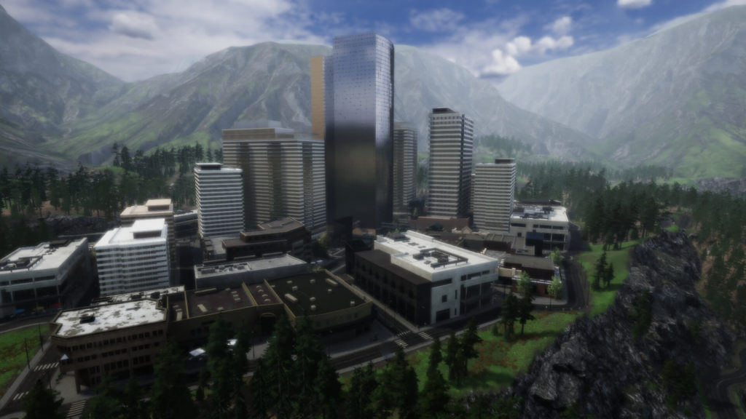
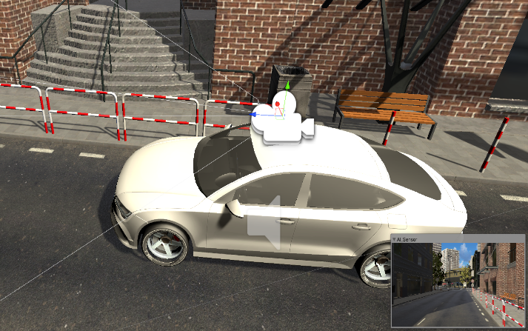
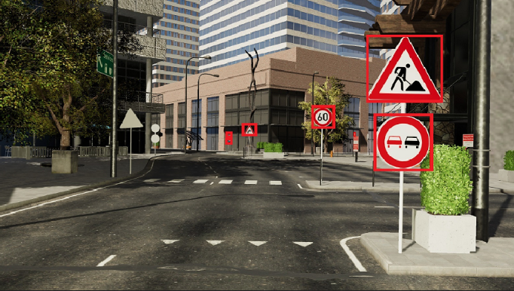
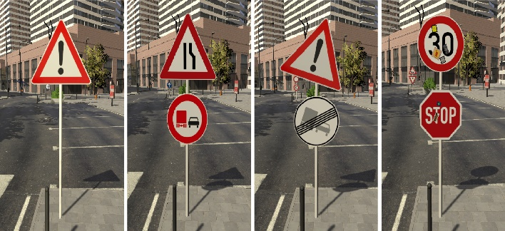
3. Implementation View
3.4 SIMULATION
Environmental component
Car component
Traffic sign component
Traffic sign recognition system

Slide 42
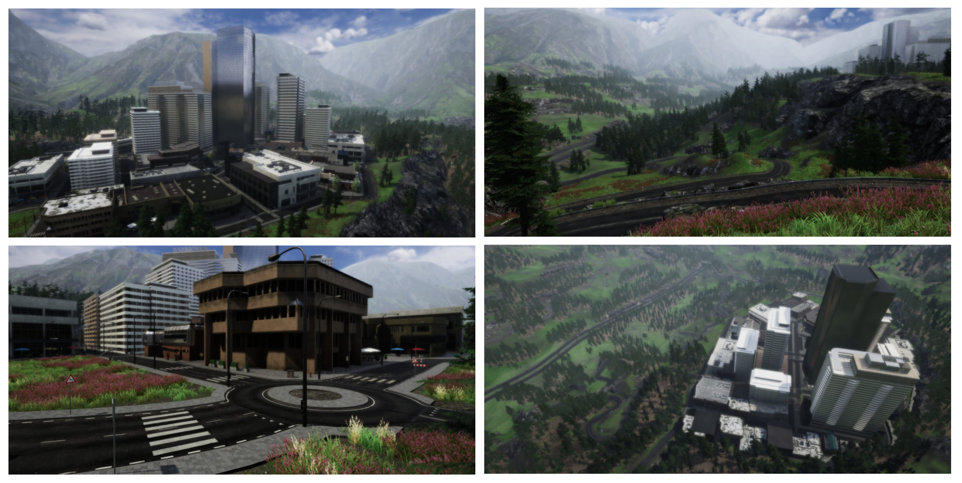
3. Implementation View
3.4 SIMULATION
ENVIRONMENTAL COMPONENT
Windridge City simulation environment
Urban roads, rural area roads, highways and forest roads
Different road textures and floor markings

Slide 43
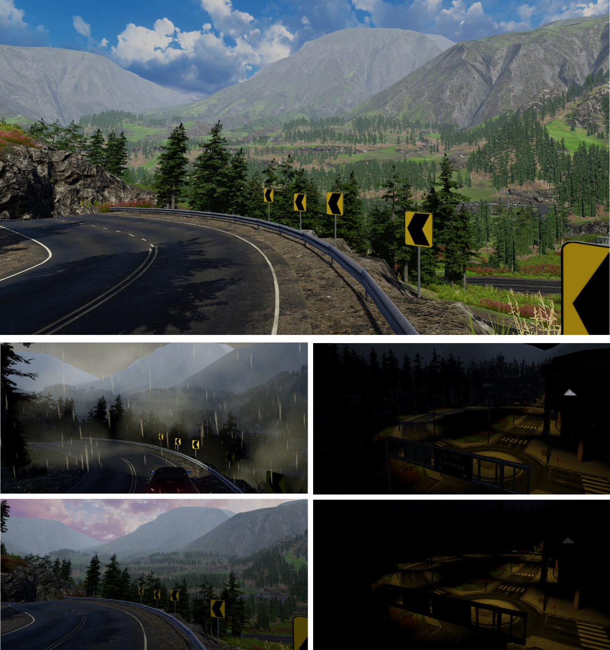
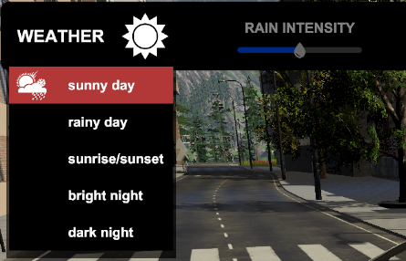
3. Implementation View
3.4 SIMULATION
ENVIRONMENTAL COMPONENT
Weather system with 5 options: sunny day, rainy day, sunrise/sunset, bright night, dark night

Slide 44
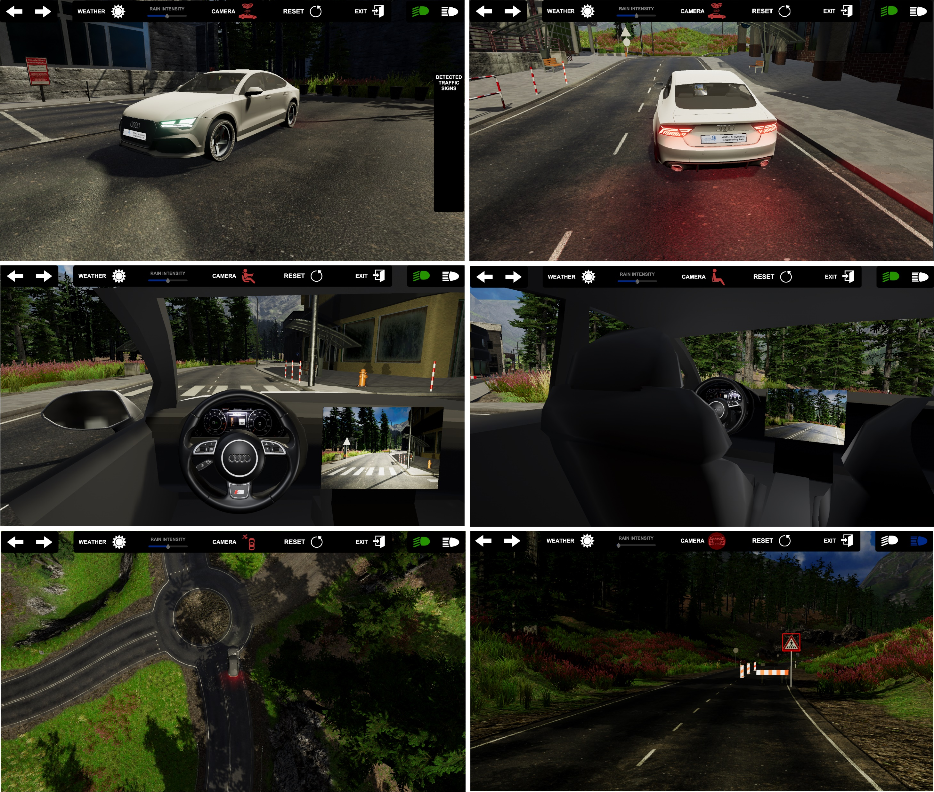
3. Implementation View
3.4 SIMULATION
INTEGRATION OF THE CAR COMPONENT
3D car model
Brake lights, active brake lights, low beam headlights, long beam headlights, turn signal lights
Camera sensor mounted on the roof
Wheel collider component
2 driving modes: autonomous driving and manual driving
5 different camera modes

Slide 45
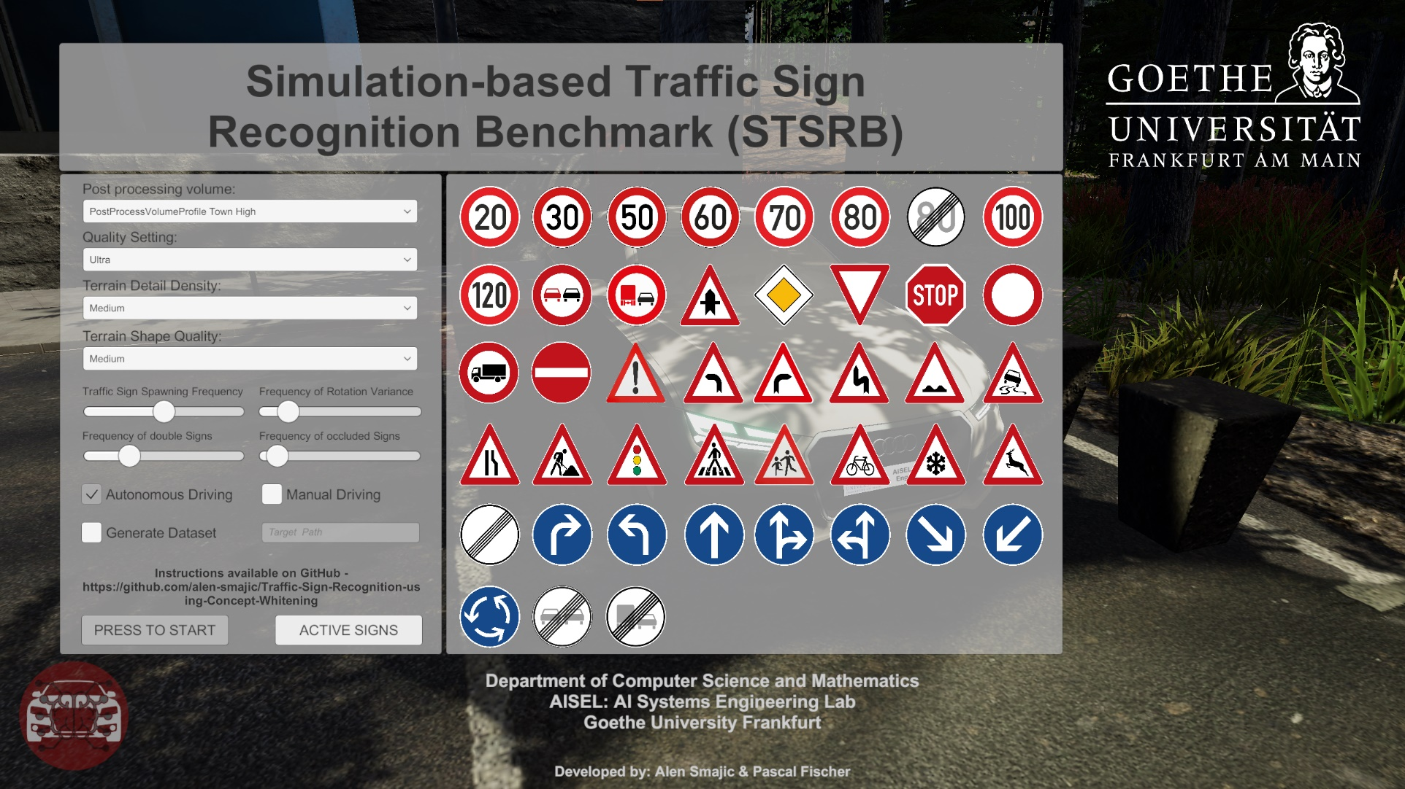
3. Implementation View
3.4 SIMULATION
INTEGRATION OF THE TRAFFIC SIGN COMPONENT
Manually generated 3D traffic sign models
Traffic sign spawn function with the following parameters: traffic sign spawning frequency, frequency of double signs, frequency of rotation variance, frequency of occluded signs
Active signs option

Slide 46

3. Implementation View
3.4 SIMULATION
INTEGRATION OF THE TRAFFIC SIGN COMPONENT
Spawn Frequency
Double Signs Frequency
Frequency of Rotation Variance
Frequency of Occluded Signs

Slide 47
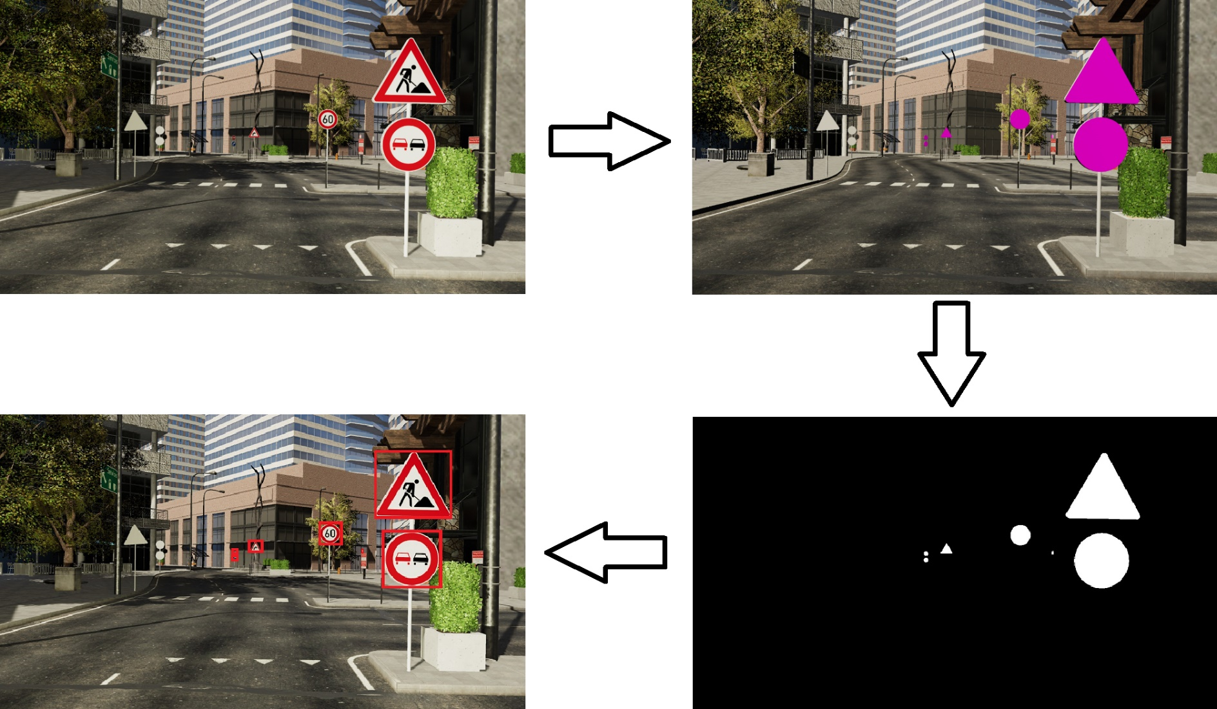
3. Implementation View
3.4 SIMULATION
DATASET GENERATION
Stops the scene every few seconds to make 2 screenshots
First screenshot is the sensor input
Second screenshot is the ground truth label (pink texture on traffic signs)
Threshold the color and use the contours function to extract the bounding box labels

Slide 48
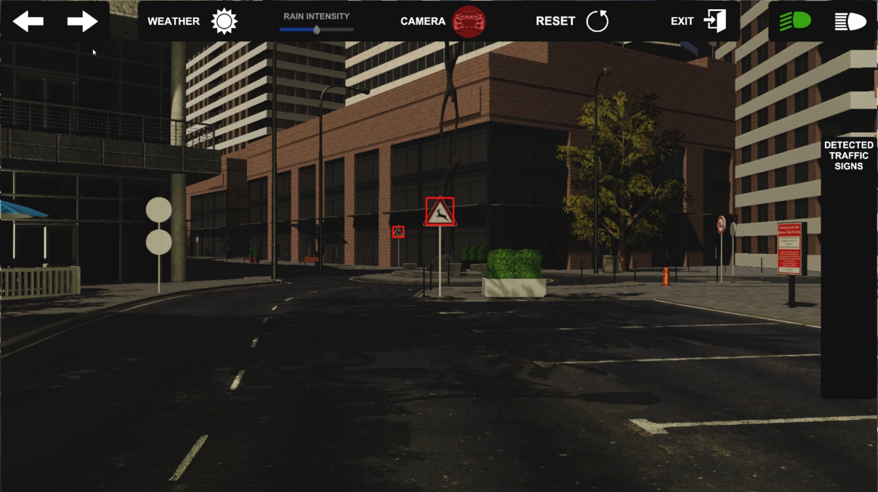
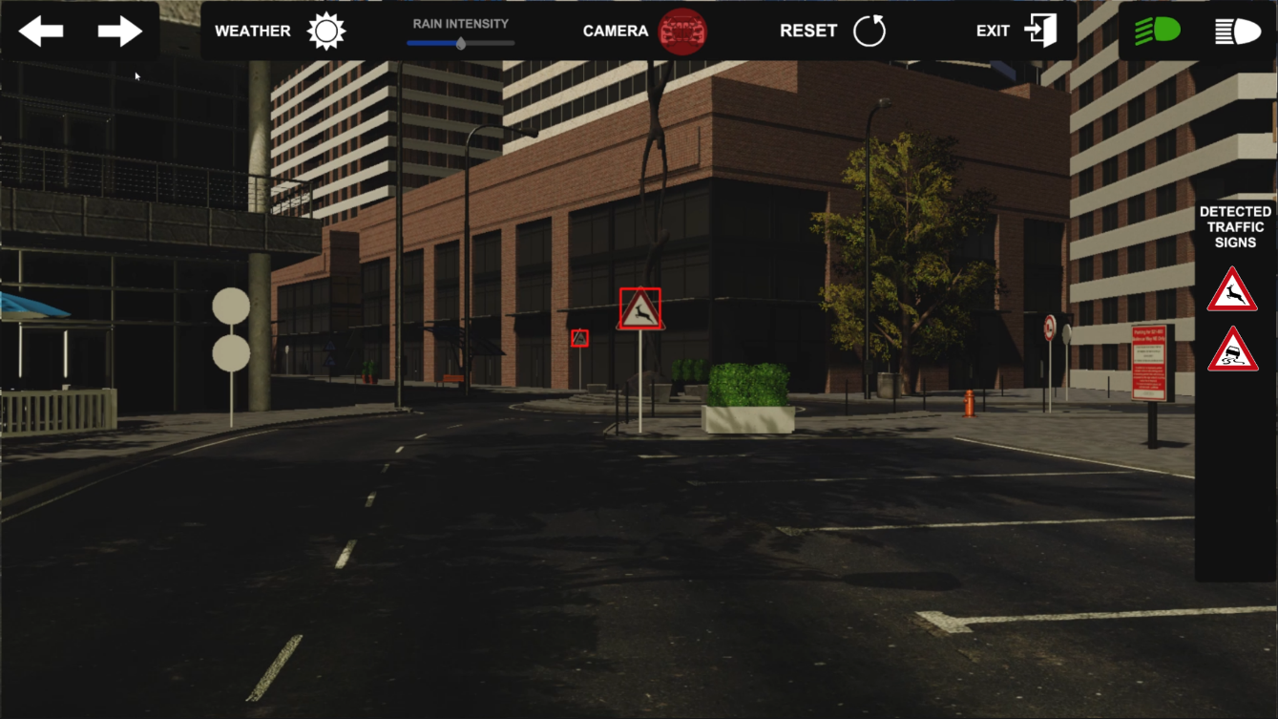
3. Implementation View
3.4 SIMULATION
INTEGRATION OF THE TRAFFIC SIGN RECOGNITION SYSTEM
Our current system
Visualisation of the future version of our system

Slide 49
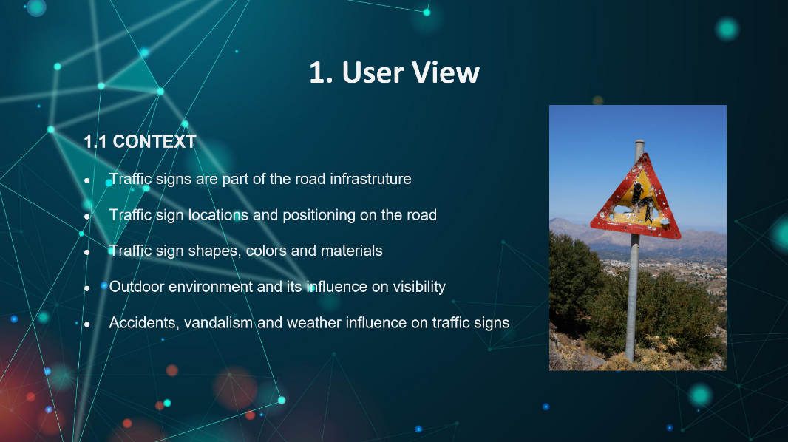
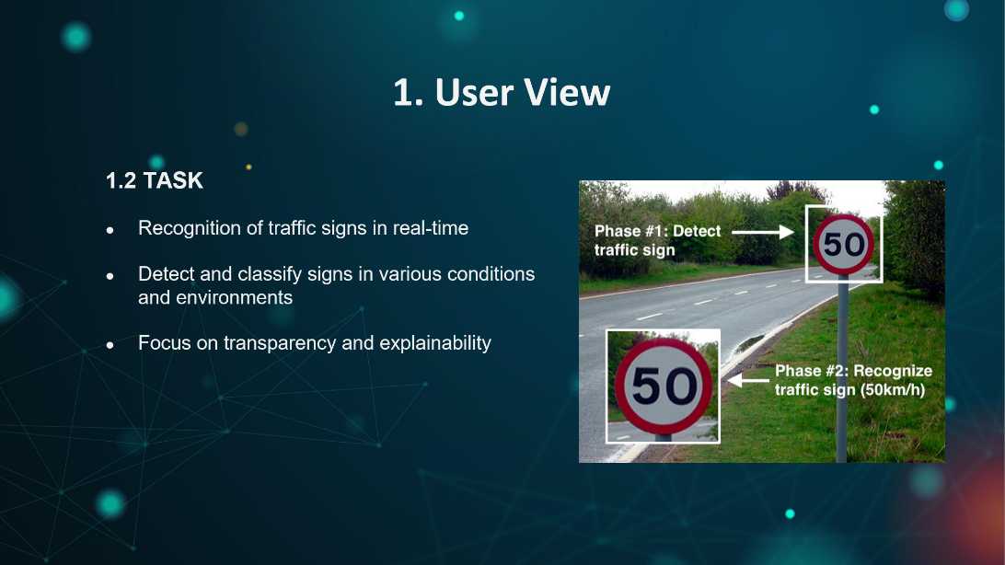
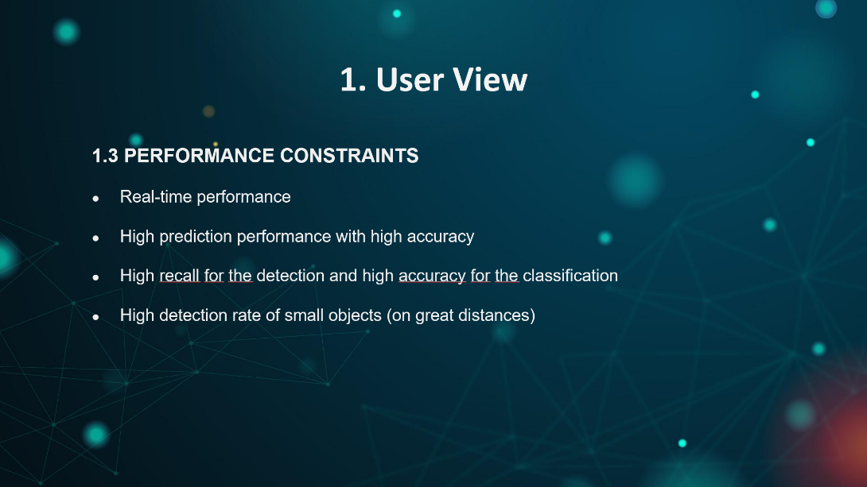
4. Conclusion and Future Work
We presented our first attempt at tackling the problem of traffic sign recognition as system engineers

Slide 50
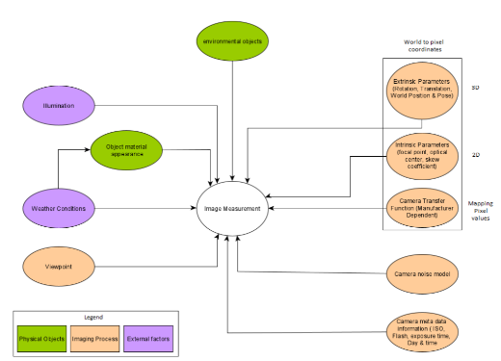
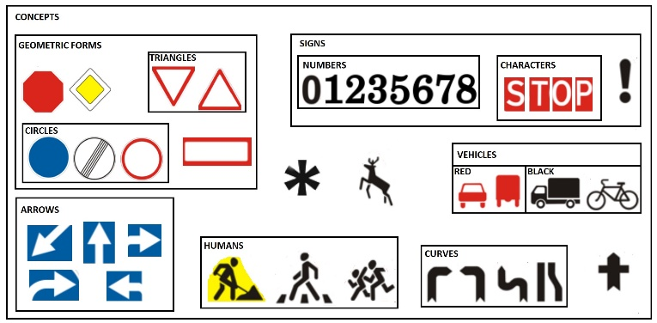


4. Conclusion and Future Work
Contextual world model
Camera sensor model
Try out new algorithms for the traffic sign detection
Expand the amount of concept whitening layers within our networks
Try out different image classification architectures

Slide 51
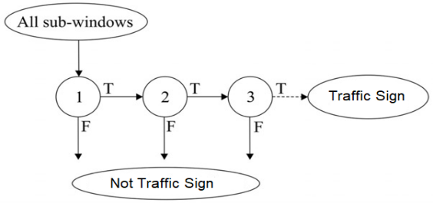
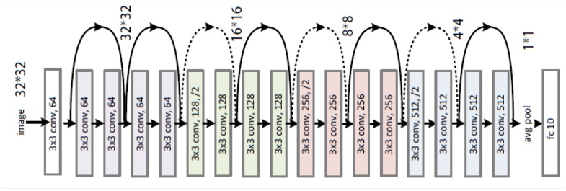
4. Conclusion and Future Work
Multistage pipeline system
Future work => exploit the fact that our system consists of 2 prediction models
Try out new algorithms for the traffic sign detection system
Expand the amount of concept whitening layers within our networks
Try out different image classification architectures

Slide 52




4. Conclusion and Future Work
Environmental component
Car component
Traffic sign component
Traffic sign recognition system
We presented a simulation for the task of traffic sign recognition
Future work => Further development of the simulation components with respect to our probabilistic environmental world model
The simulation as a benchmarking tool

Slide 53
Thank You For Your Attention
Presented by
Pascal Fischer & Alen Smajic
with support of the
AI Systems Engineering Lab

